Slide 1


AutoThinking
Here are some quick tips:
Level 1 and 2 of AutoThinking do not need logging in, but level 3 requires you to enter your information before playing the game.
Solutions that use loop, conditional, or functions get more scores compared to those only using arrows.
When debug gives you feedback or hints, this does not mean that your solution is NOT 100% good or suitable for the current situation of the maze (might be risky, might lack skills, might does not get enough scores), it means you could change your solution to have a better one.
Follow loop or conditional with a number and arrow (IMPORTANT)
To save a solution as a function you should use f1 or f2 keys and to call them f3 or f4.
The green-eyed cat moves randomly WITH repetition, according to the number of commands placed by players in the solution bar, while the blue-eyed cat moves according to the number of tiles traversed by the mouse. If, for instance, a 3-command solution make the mouse move 10 tiles, the green cat would move 3 tiles at random while the blue cat would move 10 tiles. So, you’d better think about possible movement of cats before running your solution.

Slide 2
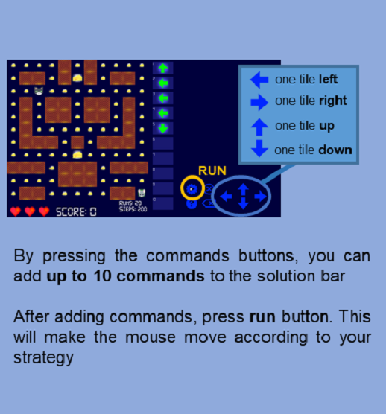
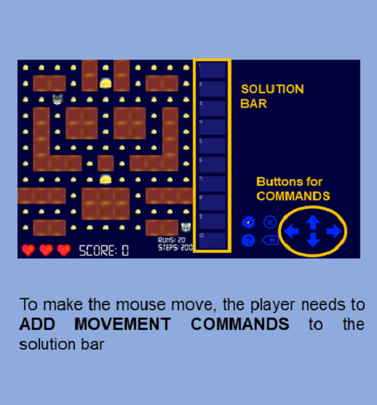
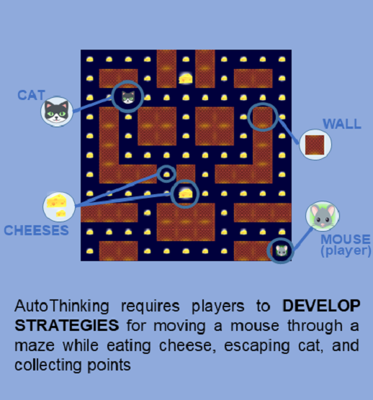

Slide 3
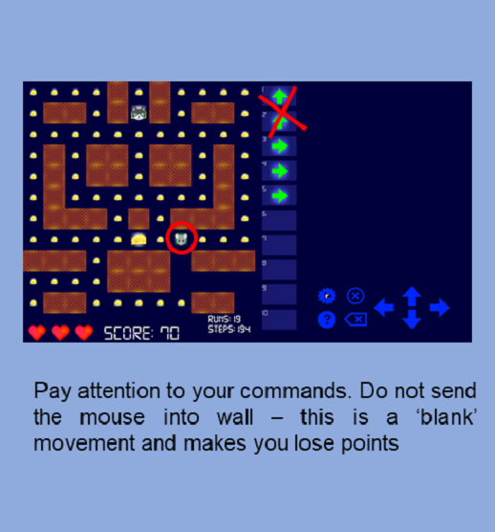
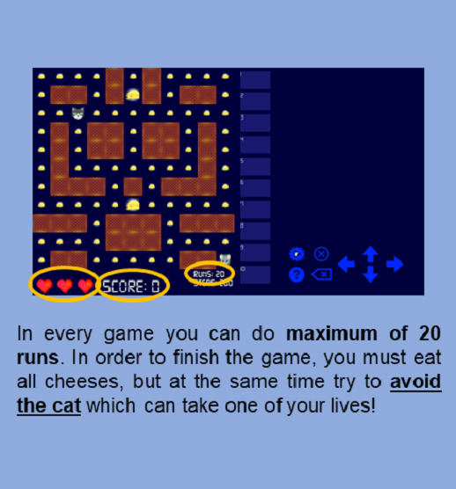
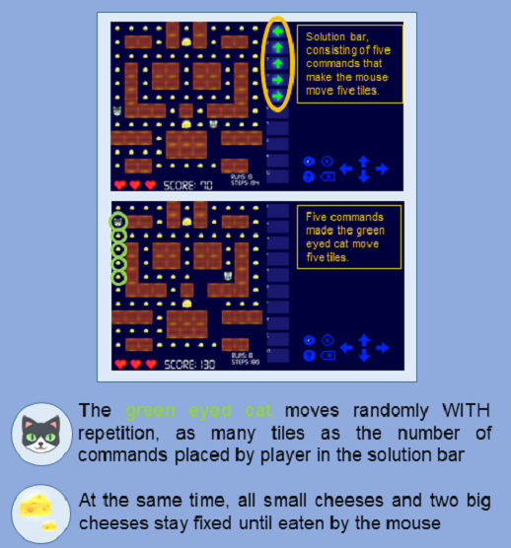

Slide 4
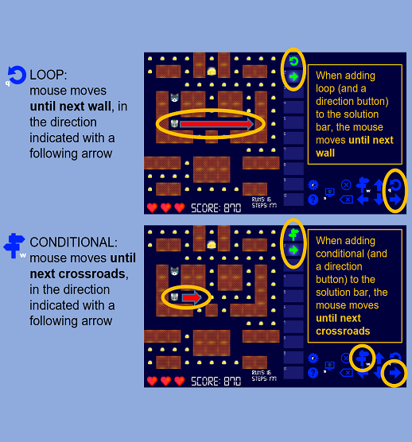
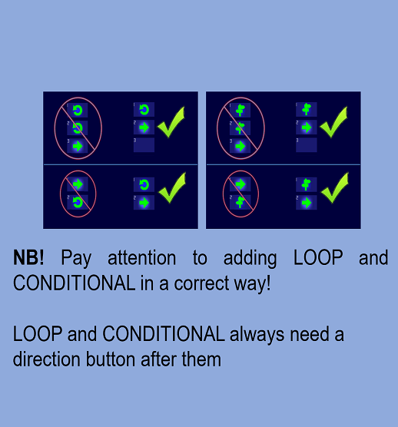
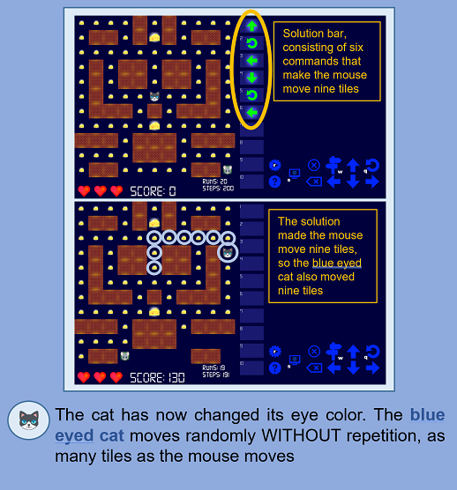
Level 2

Slide 5
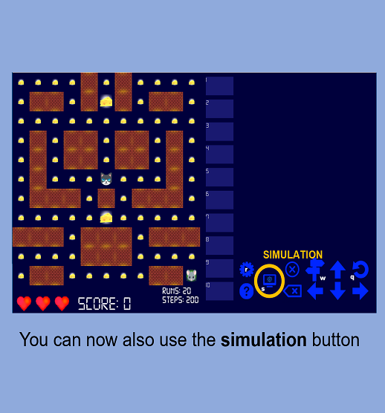
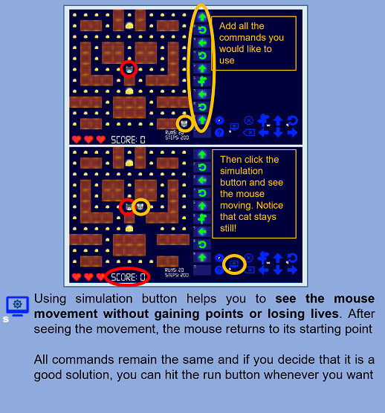
Level 2

Slide 6
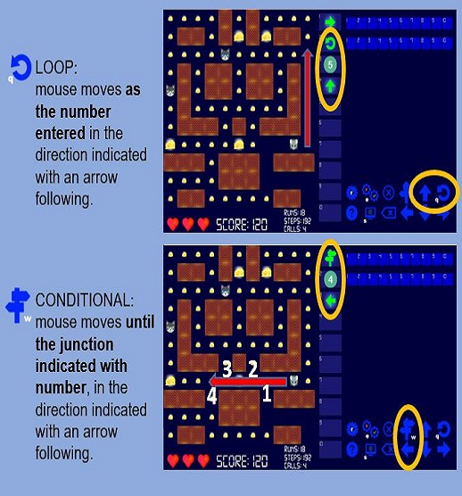
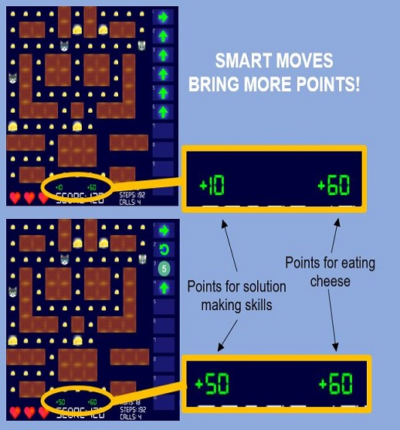
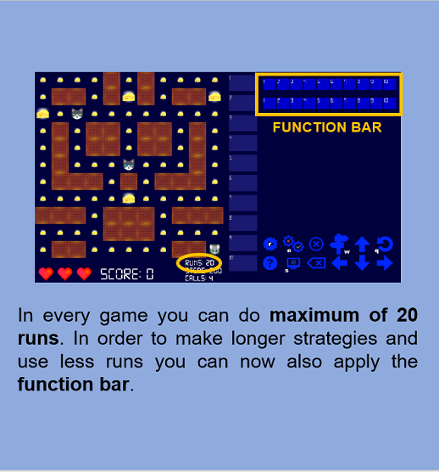
Level 3

Slide 7
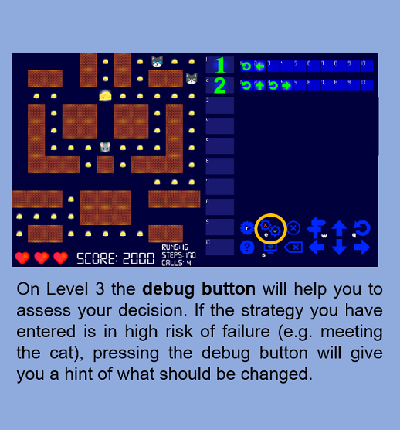
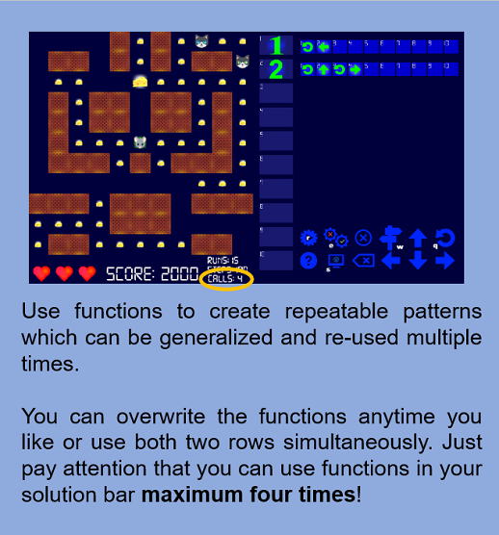
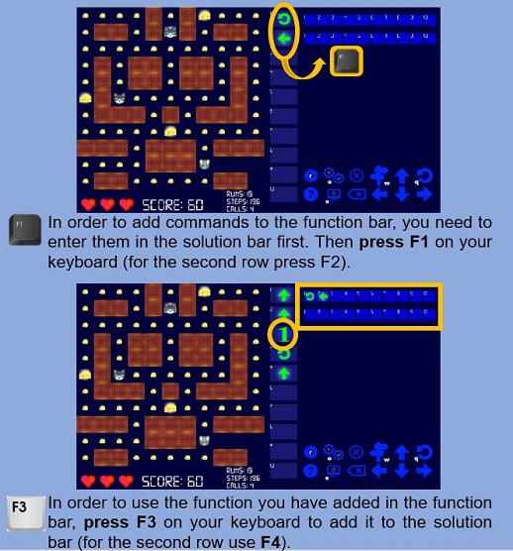
Level 3

